Slide 1
Hosea 何西阿書 5:1-15

Slide 2
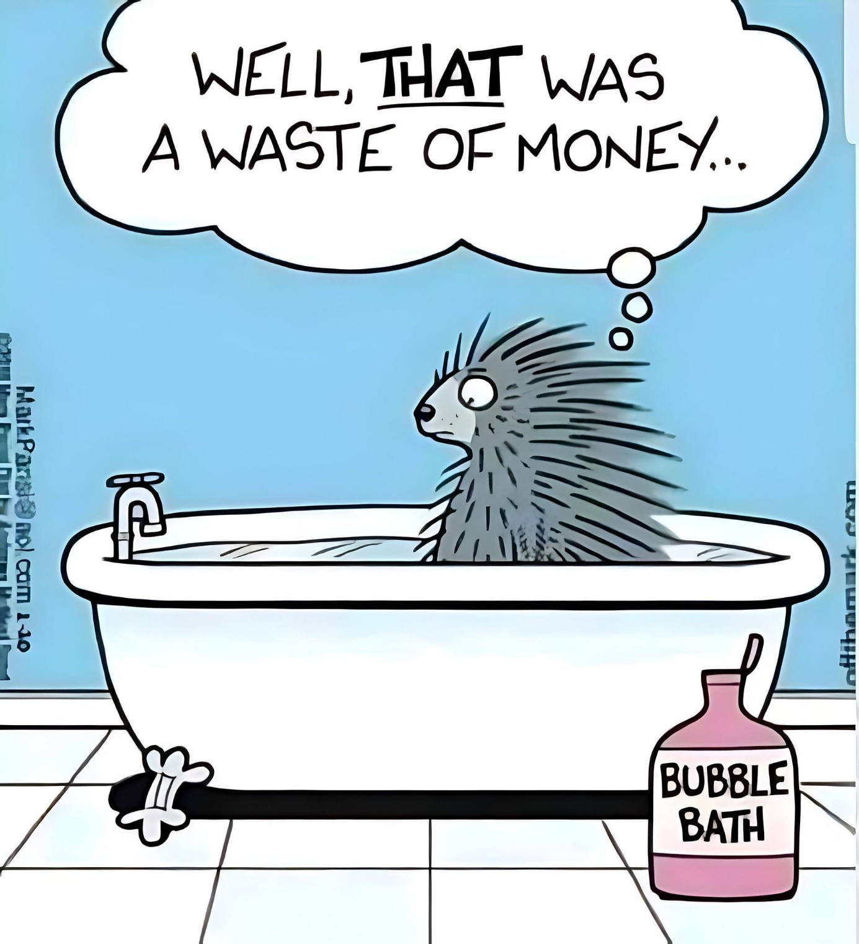
真是浪費錢
泡泡浴

Slide 3
Hosea 5:1-15
1 “Hear this, you priests! Pay attention, you Israelites! Listen, royal house! This judgment is against you:
6 When they go with their flocks and herds to seek the Lord, they will not find him; he has withdrawn himself from them. 7 They are unfaithful to the Lord; they give birth to illegitimate children.
When they celebrate their New Moon feasts, he will devour their fields.
何西阿書 5:1-15
1 眾祭司啊，要聽我的話！以色列家啊，要留心聽！王家啊，要側耳而聽！審判要臨到你們
6 他們必牽著牛羊去尋求耶和華，卻尋不見；他已經轉去離開他們。
7 他們向耶和華不忠；他們生下外邦的兒女。當他們守新月節的時候，耶和華必吞滅他們的田地。

Slide 4
10 Judah’s leaders are like those who move boundary stones. I will pour out my wrath on them like a flood of water.
11 Ephraim is oppressed, trampled in judgment, intent on pursuing idols.
12 I am like a moth to Ephraim, like rot to the people of Judah.
13 “When Ephraim saw his sickness, and Judah his sores, then Ephraim turned to Assyria, and sent to the great king for help. But he is not able to cure you, not able to heal your sores.
14 For I will be like a lion to Ephraim, like a great lion to Judah. I will tear them to pieces and go away; I will carry them off, with no one to rescue them.
15 Then I will return to my lair until they have borne their guilt and seek my face— in their misery they will earnestly seek me.”
10 猶大的首領如同挪移地界的人，我必將忿怒倒在他們身上，如水一般。
11 以法蓮因樂從人的命令，就受欺壓，被審判壓碎。
12 我使以法蓮如蟲蛀之物，使猶大家如朽爛之木。
13 以法蓮見自己有病，猶大見自己有傷，他們就打發人往亞述去見耶雷布王，他卻不能醫治你們，不能治好你們的傷。
14 我必向以法蓮如獅子，向猶大家如少壯獅子。我必撕裂而去，我要奪去，無人搭救。
15 我要回到原處，等他們自覺有罪，尋求我面；他們在急難的時候必切切尋求我。

Slide 5
Imagine you are Hosea 想像你是何西阿

Slide 6
The book of Hosea shares
1.) The People’s offenses against God
2.) How God feels about his adulterous unfaithful people he loves.
3.) How God responds.
何西阿書分享了
1)百姓得罪神的行為
2)神對他所愛卻行淫背道的百姓的心情
3)神的回應

Slide 7
The People’s offenses against God
5:3 Ephraim, you have now turned to prostitution
5:4 a spirit of prostitution is in their heart
5:7 They are unfaithful to the Lord
5:3 Israel is corrupt.
5:5 stumble in their sin (& Wickedness)
5:4 they do not acknowledge the Lord.
百姓得罪神的行為
5:3 以法蓮哪，現在你行淫了
5:4 有淫心在他們裡面
5:7 他們向耶和華不忠。
5:3 以色列被玷污了
5:5 因自己的罪孽跌倒
5:4 他們也不認識耶和華

Slide 8
The People’s offenses against God
5:5 Israel’s arrogance testifies against them;
5:11 intent on pursuing idols.
5:13 then Ephraim turned to Assyria, and sent to the great king for help.
百姓得罪神的行為
5:5 以色列的驕傲當面見證自己。
5:11 心意專注追隨偶像。
5:13 以法蓮就投靠亞述，差人往大王那裡求助。

Slide 9
2.) How God feels about his adulterous unfaithful idolatrous people he saved, he gave a home, he loves.
3.) How God responds.
2) 神對他所救、賜居所、所愛的百姓——他們行淫、背道、拜偶像——的心情
3) 神的回應

Slide 10
God Judges / Holds Accountable
Hosea 5:1 “Hear this, you priests! Pay attention, you Israelites! Listen, royal house! This judgment is against you:
神施行審判／追究責任
何西阿書5:1 “眾祭司啊，要聽我的話！以色列家啊，要留心聽！王家啊，要側耳而聽！審判要臨到你們”

Slide 11
What is Judgment?
It is accountability.
審判是什麼？
就是對所行之事負責。

Slide 12
Why does God judge, hold us accountable? What is its purpose?
Learn and Turn from our wicked ways (repent)
Come back to God our first love.
為什麼神要施行審判，追究我們的責任？為何目的？
要讓我們學習並離開邪惡的道路（悔改）
回轉向神，回到起初對祂的愛

Slide 13
God gets angry & frustrated
Hosea 5:10 I will pour out my wrath on them...
神因百姓的背道而發怒
何西阿書 5:10 我必將忿怒倒在他們身上，如水一般

Slide 14
God Withdraws
Hosea 5:6 When they go with their flocks and herds to seek the Lord, they will not find him; he has withdrawn himself from them.
神轉去離開
何西阿書 5:6 他們必牽著牛羊去尋求耶和華，卻尋不見；他已經轉去離開他們

Slide 15
God Punishes and/or Allows Us to Reap the Consequence of Our Choices
Hosea 5:14 For I will be like a lion to Ephraim, like a great lion to Judah. I will tear them to pieces and go away; I will carry them off, with no one to rescue them.
神懲罰我們，讓我們承擔自己選擇的後果
何西阿書 5:14 我必向以法蓮如獅子，向猶大家如少壯獅子。我必撕裂而去，我要奪去，無人搭救

Slide 16
The Purpose of Punishment is
1.) Correcting Our Heart and Behavior
2.) Calling Us Back to God (His Love, His Protection)
Sometimes
1.) God causes the correction.
2.) God Allows Us to Reap the Consequences of Our Choices.
懲罰的目的
1) 改正我們的心與行為
2) 呼召我們回轉向神（他的愛，他的保護）
有時候
1) 神親自施行改正
2) 神讓我們承受自己選擇的後果

Slide 17
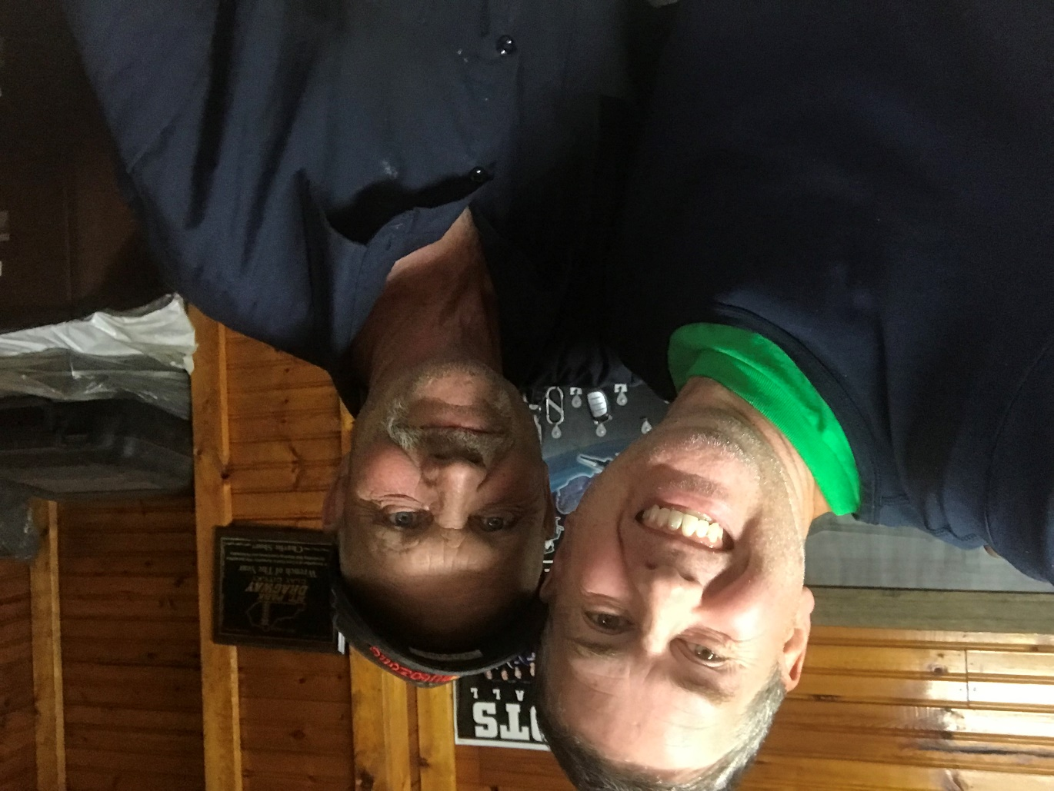
Revelation 3:19 Those whom I love I rebuke and discipline. So be earnest and repent.
啟示錄 3:19 凡我所疼愛的，我就責備管教他，所以你要發熱心，也要悔改。

Slide 18
God calls us take Responsibility
Hosea 5:15 Then I will return to my lair until they have borne their guilt and seek my face— in their misery they will earnestly seek me.
神呼召我們承擔責任
何西阿書 5:15 我要回到原處，等他們自覺有罪，尋求我面；他們在急難的時候必切切尋求我。

Slide 19
God calls us to True Repentance & Return
Hosea 5:15 Then I will return to my lair until they have borne their guilt and seek my face— in their misery they will earnestly seek me.”
神呼召我們真心悔改並回轉
何西阿書 5:15 我要回到原處，等他們自覺有罪，尋求我面；他們在急難的時候必切切尋求我。

